Slide 1
Machine Learning Unsupervised Learning K-mean Clustering
Instructor: Zainab Yousuf

Slide 2
Content
Clustering
Clustering vs. Classification
K-mean Clustering Algorithm
Example of k-mean clustering

Slide 3
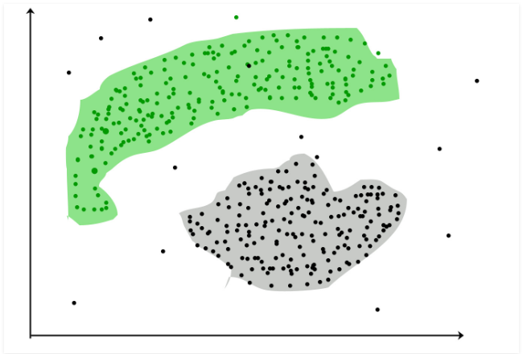
Clustering
It is machine learning approach that comes under the unsupervised learning
Clustering is to group together similar items using different similarity measures.
As its unsupervised learning approach therefore, machine will learn on its own, using the input data only (learning set), and will classify the objects into a particular group.

Slide 4
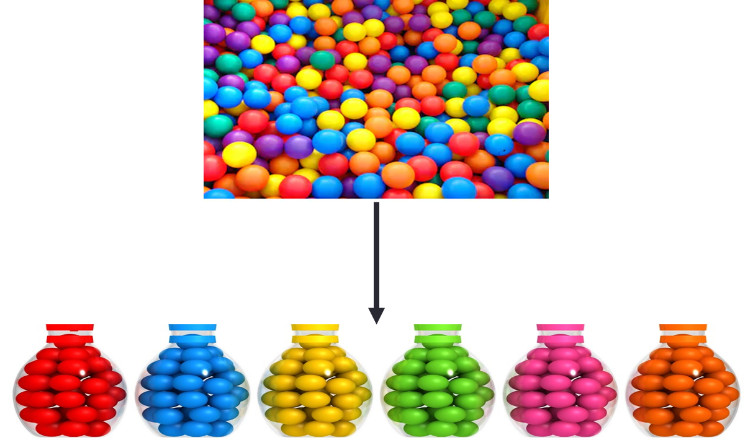
Example
Providing with balls of different colors, the clustering will group them into separate clusters or groups on the basis of color intensity
Y
Blue
Z
Green
Red
X

Slide 5
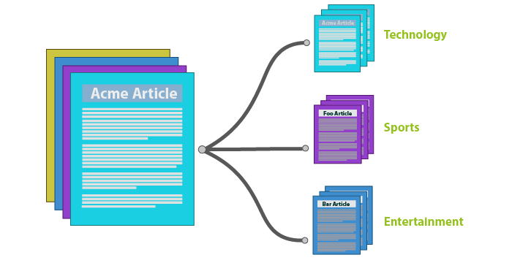
Example
Providing with articles of different topics, the clustering will group them into separate clusters or groups on the basis of words’ similarity

Slide 6
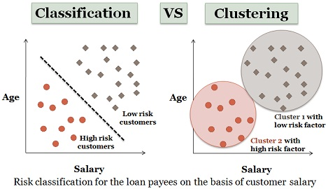
Classification vs. Clustering
Classification
Clustering
Labeled data points
Find a rule (decision line) that assign label to new point
Supervised Learning approach
Dataset is not labeled
Group points which are closer to each other
Unsupervised learning approach

Slide 7
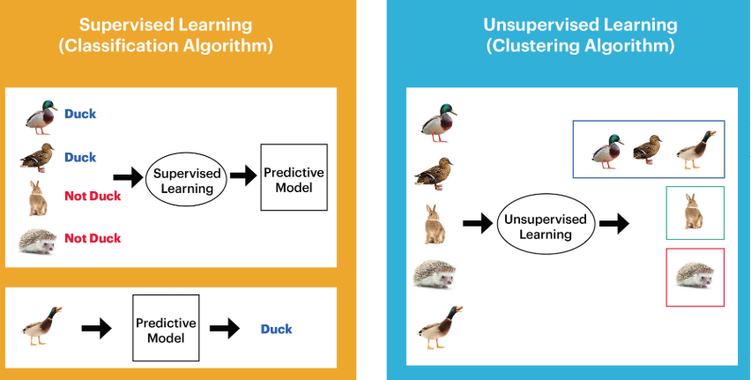
Classification vs. Clustering

Slide 8
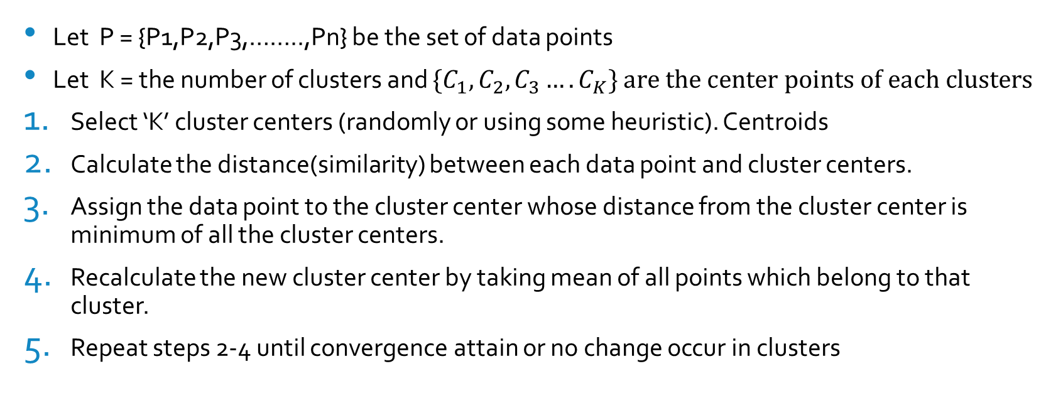
K-Means Clustering
Let P = {P1,P2,P3,……..,Pn} be the set of data points
Let K = the number of clusters and ${\{C}_{1},C_{2},C_{3}….C_{K}\}$ $are the center points of each clusters$
Select ‘K’ cluster centers (randomly or using some heuristic). Centroids
Calculate the distance(similarity) between each data point and cluster centers.
Assign the data point to the cluster center whose distance from the cluster center is minimum of all the cluster centers.
Recalculate the new cluster center by taking mean of all points which belong to that cluster.
Repeat steps 2-4 until convergence attain or no change occur in clusters

Slide 9
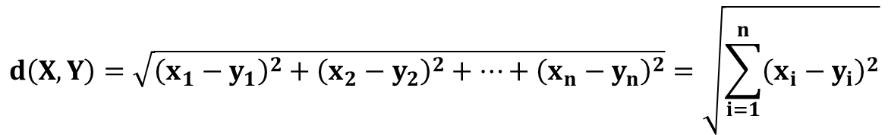
Similarity Measure in Clustering
The most popular (dis) similarity measure for continuous features are Euclidean Distance.
We plot the data in n-D space (n is the number of input features) and then calculate the distance between two position.
The formula to compute Euclidean Distance is as follow:
$$d\left(X,Y\right)=\sqrt{{\left(x_{1}−y_{1}\right)}^{2}+{\left(x_{2}−y_{2}\right)}^{2}+…+{\left(x_{n}−y_{n}\right)}^{2}}=\sqrt{\sum_{i=1}^{n}{{\left(x_{i}−y_{i}\right)}^{2}}}$$

Slide 10
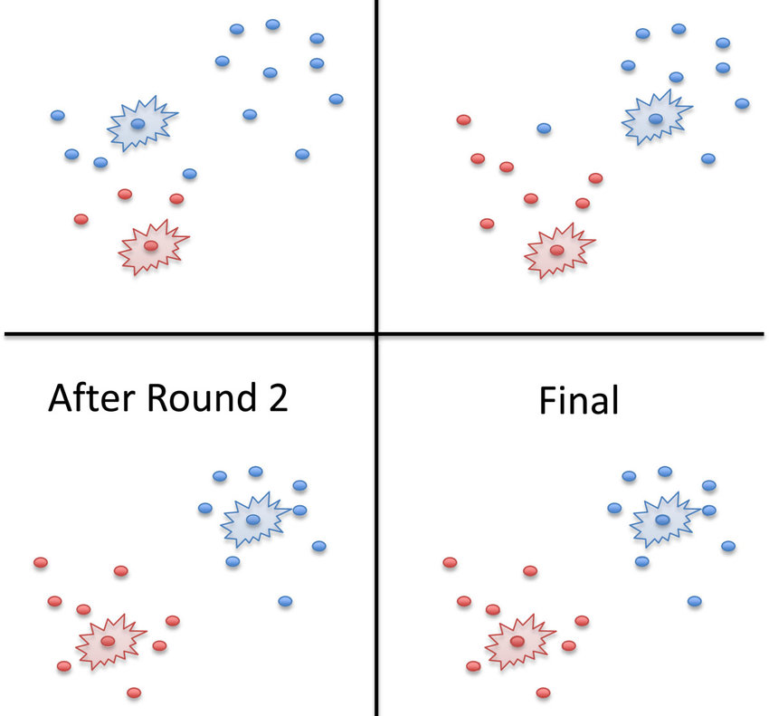
K-Means Clustering
It is an iterative approach
It starts by picking some random center points, then gradually refine those clusters by re-estimating the center points of each cluster in an iterative manner.
It stops when cluster get stable---no change in cluster members

Slide 11
Example
Cluster the following eight points (with (x, y) representing locations) into three clusters P1(2, 10) P2(2, 5) P3(8, 4) P4(5, 8) P5(7, 5) P6(6, 4) P7(1, 2) P8(4, 9).
Initial cluster centers, chosen randomly, are: C1=P1=(2, 10), C2=P4=(5, 8) and C3=P7=(1, 2).
The distance function between two points a=(x1, y1) and b=(x2, y2) is defined as: ρ(a, b) = |x2 – x1| + |y2 – y1| .
Use k-means algorithm to find the three cluster centers after the second iteration.

Slide 12
Example: k-Mean Clustering
Iteration 1
 |  | C1= (2, 10) | C2= (5, 8) | C3=(1, 2)
 | Point | Dist Mean 1 | Dist Mean 2 | Dist Mean 3 | Cluster
P1 | (2, 10)
P2 | (2, 5)
P3 | (8, 4)
P4 | (5, 8)
P5 | (7, 5)
P6 | (6, 4)
P7 | (1, 2)
P8 | (4, 9)

Slide 13
Example: k-Mean Clustering
Iteration 1
Calculate distance of P1 with C1, C2 and C3
Assign P1 to a cluster with minimum distance
P1 C1
x1, y1 x2, y2
(2, 10) (2, 10)
ρ(a, b) = |x2 – x1| + |y2 – y1|
ρ(P1,C1) = |x2 – x1| + |y2 – y1|
= |2 – 2| + |10 – 10|
= 0 + 0
= 0
P1 C2
x1, y1 x2, y2
(2, 10) (5, 8)
ρ(a, b) = |x2 – x1| + |y2 – y1|
ρ(P1, C2) = |x2 – x1| + |y2 – y1|
= |5 – 2| + |8 – 10|
= 3 + 2
= 5
P1 C3
x1, y1 x2, y2
(2, 10) (1, 2)
ρ(a, b) = |x2 – x1| + |y2 – y1|
ρ(P1, C3) = |x2 – x1| + |y2 – y1|
= |1 – 2| + |2 – 10|
= 1 + 8
= 9
So, which cluster should the point (2, 10) be placed in? The one, where the point has the shortest distance to the mean – that is mean 1 (cluster 1), since the distance is 0.

Slide 14
Example: k-Mean Clustering
Iteration 1
After calculating distance of P1 with all three clusters
 |  | C1= (2, 10) | C2= (5, 8) | C3=(1, 2)
 | Point | Dist Mean 1 | Dist Mean 2 | Dist Mean 3 | Cluster
P1 | (2, 10) | 0 | 5 | 9 | 1
P2 | (2, 5)
P3 | (8, 4)
P4 | (5, 8)
P5 | (7, 5)
P6 | (6, 4)
P7 | (1, 2)
P8 | (4, 9)

Slide 15
Example: k-Mean Clustering
Iteration 1
Now, calculate distance of P2 with C1, C2 and C3
Assign P2 to a cluster with minimum distance
P2 C1
x1, y1 x2, y2
(2, 5) (2, 10)
ρ(a, b) = |x2 – x1| + |y2 – y1|
ρ(P2, C1) = |x2 – x1| + |y2 – y1|
= |2 – 2| + |10 – 5|
= 0 + 5
= 5
P2 C2
x1, y1 x2, y2
(2, 5) (5, 8)
ρ(a, b) = |x2 – x1| + |y2 – y1|
ρ(P2, C2) = |x2 – x1| + |y2 – y1|
= |5 – 2| + |8 – 5|
= 3 + 3
= 6
P2 C3
x1, y1 x2, y2
(2, 5) (1, 2)
ρ(a, b) = |x2 – x1| + |y2 – y1|
ρ(P2,C3) = |x2 – x1| + |y2 – y1|
= |1 – 2| + |2 – 5|
= 1 + 3
= 4
So, which cluster should the point (2, 5) be placed in? The one, where the point has the shortest distance to the mean – that is mean 3 (cluster 3), since the distance is 4.

Slide 16
Example: k-Mean Clustering
Iteration 1
After calculating distance of P2 with all three clusters
 |  | C1= (2, 10) | C2= (5, 8) | C3=(1, 2)
 | Point | Dist Mean 1 | Dist Mean 2 | Dist Mean 3 | Cluster
P1 | (2, 10) | 0 | 5 | 9 | 1
P2 | (2, 5) | 5 | 6 | 4 | 3
P3 | (8, 4)
P4 | (5, 8)
P5 | (7, 5)
P6 | (6, 4)
P7 | (1, 2)
P8 | (4, 9)

Slide 17
Example: k-Mean Clustering
Iteration 1:
After calculating distance of each point with all three clusters.
 |  | C1= (2, 10) | C2= (5, 8) | C3=(1, 2)
 | Point | Dist Mean 1 | Dist Mean 2 | Dist Mean 3 | Cluster
P1 | (2, 10) | 0 | 5 | 9 | 1
P2 | (2, 5) | 5 | 6 | 4 | 3
P3 | (8, 4) | 12 | 7 | 9 | 2
P4 | (5, 8) | 5 | 0 | 10 | 2
P5 | (7, 5) | 10 | 5 | 9 | 2
P6 | (6, 4) | 10 | 5 | 7 | 2
P7 | (1, 2) | 9 | 10 | 0 | 3
P8 | (4, 9) | 3 | 2 | 10 | 2

Slide 18
Example: k-Mean Clustering
Iteration 1: Recalculating the centroid/mean
Old Mean/Centroid | C1= (2, 10) | C2= (5, 8) | C3=(1, 2)
 | P1 = (2, 10) | P3=(8, 4) | P2=(2, 5)
 |  | P4= (5, 8) | P7= (1, 2)
 |  | P5= (7, 5)
 |  | P6= (6, 4)
 |  | P8= (4, 9)
 |  | =( (8+5+7+6+4)/5, (4+8+5+4+9)/5 ) | =( (2+1)/2, (5+2)/2 )
New Mean/Centroid | C1= (2, 10) | C2 = (6, 6) | C3= = (1.5, 3.5)

Slide 19
a)
b)
c)
d)
The initial cluster centers are shown in red (.). The new cluster centers are shown in red (x)

Slide 20
Example: k-Mean Clustering
That was Iteration1 (epoch1).
In Iteration2, we basically repeat the process from Iteration1 this time using the new means we computed.
Next, we go to Iteration3, Iteration4, and so on until the means do not change anymore.
After the 2nd iteration, the result would be:
C1= {P1, P8}, C2={P3,P4,P5,P6} and C3={P2,P7}
C1={3,9.5}, C2={6.5,5.25} and C3={1.5,3.5}
After the 3rd iteration, the result would be:
C1= {P1,P4, P8}, C2={P3,P5,P6} and C3={P2,P7}
C1={3.66,9}, C2={7,4.33} and C3={1.5,3.5}

Slide 21
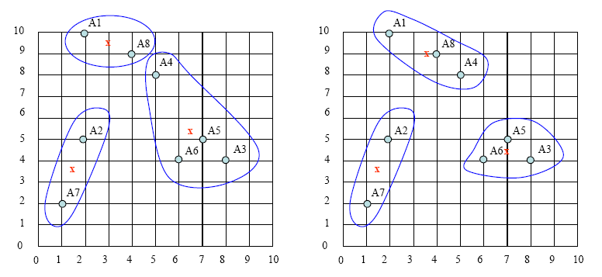
Clusters after 2nd and 3rd Iteration

Slide 22
Testing
Lets T=(9,20) is the test Data
After finalizing the clusters using the training data, we can perform testing on this new data T.
For testing, we will compute the distance between new Data point T with the center points of final clusters
The new Data point T will be assign to the closest cluster.

Slide 23
K-Nearest Neighbor (KNN) vs. K-Mean Clustering
KNN
K-Mean
It is a Supervised Learning approach
It does not have any training phase. It directly compute the similarity between test point with each point in training set.
K represents the first K results. It is used to choose the most frequently appearing class name among first k rows.
It is a Unsupervised Learning approach
It performs training or learned clusters over training sets. Then find similarity between the test data and centroids of the learned clusters only.
K represents the number of clusters

Slide 24
Thank You

